Slide 1
Notes:
FACILITATOR NOTE:
The Person-Centric Wellness Model is published by Mather Institute.
For more detailed information on the model and research, request the orange paper at: https://www.matherinstitute.com/senior-living-professionals/person-centric-wellness-model/
.

Slide 2
Traveling to different sites
Playing with my pets
Spending time with my family
Cultivating spiritual connections
Convening with nature
WHAT IS WELLNESS FOR YOU?
Doing what I love
Being able to take care of others
Feeling fulfilled and happy
Living in a safe and comfortable environment
Feeling healthy
Notes:
Today we’ll be discussing our approach to wellness.
ASK:
What does wellness mean to you? Every one of might say something different.

Slide 3
Traveling to different sites
Playing with my pets
Spending time with my family
Cultivating spiritual connections
Convening with nature
WELLNESS LOOKS DIFFERENT FOR EVERYONE
Doing what I love
Being able to take care of others
Feeling fulfilled and happy
Living in a safe and comfortable environment
Feeling healthy
Notes:
At the heart of our new model is this idea that wellness looks different for everyone. While for one person, spirituality may be central to their wellness, another person may place their focus somewhere completely different.

Slide 4
WHY A NEW WELLNESS MODEL?
PHYSICAL
EMOTIONAL
The 6-Dimensional Model of Wellness was designed in 1976 and has served the industry well for over 40 years.
It emphasizes that well-being goes beyond just physical health.
SOCIAL
INTELLECTUAL
VOCATIONAL
SPIRITUAL
Notes:
Before we launch into the new model, I wanted to provide some context for why we believed a new way of thinking about wellness was needed. Some of you may already be aware of this, but for many years, the focus was on six (or more) dimensions of wellness: physical, emotional, social, intellectual, vocational, and spiritual.
How many of you are familiar with the 6 dimensions of wellness? The idea is that we can support holistic, whole person wellness by focusing on these six areas.
We often described it as a wellness wheel. The goal was to stay strong in all of these areas.
A strength of this approach is that it gave us a tool to talk about how wellness is more than just physical health. This was important for communicating the idea of whole person wellness. However, there were also some limitations of this approach.

Slide 5

WHY A NEW WELLNESS MODEL?
Limitations of 6 dimensions of wellness model:
  Focuses on different “kinds” of wellness vs. creating conditions for wellness to flourish
  Implies that wellness is something that can be achieved only if an individual addresses each of the 6 dimensions
Wellness looks different for each person.
Notes:
The 6 dimensions of wellness model was more focused on types of wellness than on creating conditions or creating environments that encourage wellness.
The model also implied that a person could only be well if they were high in all 6 wellness dimensions. But that didn’t necessarily work for everyone. What if someone has a chronic health condition? What if someone wasn’t traditionally religious? What if someone is developing memory problems or has dementia? Can these people not be well and live a fulfilling life?
We wanted a vision of wellness that’s accessible to everyone. Which meant that wellness may look different for each person.

Slide 6

A “PERSON-CENTRIC APPROACH” TO WELLNESS
Recognizes an individual’s unique wants and needs, as well as the influence of the environment on their wellness.
We define wellness as the process of engaging in behaviors and decisions that enable people to reach their full potential.
Notes:
Based on that, we wanted to adopt a wellness model that recognizes an individual’s unique wants and needs, as well as the influence of the environment on their wellness.
We define wellness as the process of engaging in behaviors and decisions that enable people to reach their full potential.

Slide 7

A RESEARCH-BASED APPROACH TO WELLNESS
Mather Institute reviewed well-established models of psychological well-being and quality of life as well as research in positive aging to identify factors that could be incorporated into a new model.
Self-Determination Theory
Social Ecological Model
Notes:
As part of the development process, Mather Institute reviewed many well-established models of well-being and quality of life, and research on positive aging to identify factors to incorporate in the model. Founded in 1999, Mather Institute is dedicated to enhancing the lives of older adults. Through evidence-based research and collaborative studies, we create new Ways to Age WellSM by sharing important information and innovations that help guide the senior living industry.
The Person-Centric Wellness Model incorporates aspects of two main models:
Self-Determination Theory proposes that we have basic psychological needs and when those needs are met, it fuels our internal motivations, development, and ultimately wellness. So we incorporated the idea that creating situations that fulfill these basic needs creates conditions that motivates people toward wellness.
Socioecological model – highlights that there are many external factors that also impact our wellness. A big change from our previous wellness model is that we’re explicitly considering how our environments impact wellness.
Please see the Person-Centric Wellness Model Orange Paper for more information and citations. https://www.matherinstitute.com/person-centric-wellness-model/

Slide 8
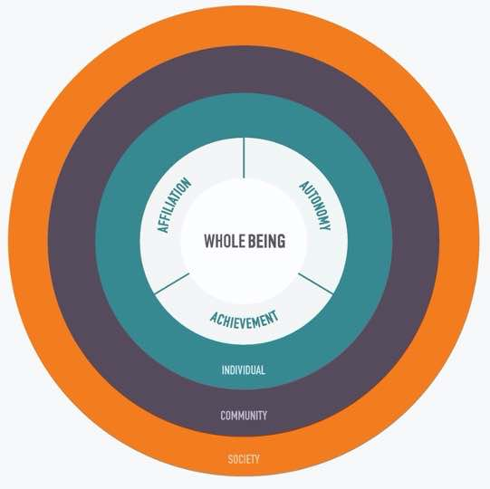



ACHIEVING INDIVIDUAL WELLNESS STARTS WITH STRAIGHT A’S
PERSON- CENTRIC WELLNESS
AUTONOMY
ACHIEVEMENT
AFFILIATION
Notes:
Mather Institute’s Person-Centric Wellness Model allows us to move beyond the dimensions of wellness to understand how personal well-being can be achieved through the key pillars of autonomy, affiliation, and achievement. The model also highlights how personal wellbeing is influenced by our individual characteristics and our environment, both in terms of our specific community and our society. We’ll unpack each of these sections.

Slide 9
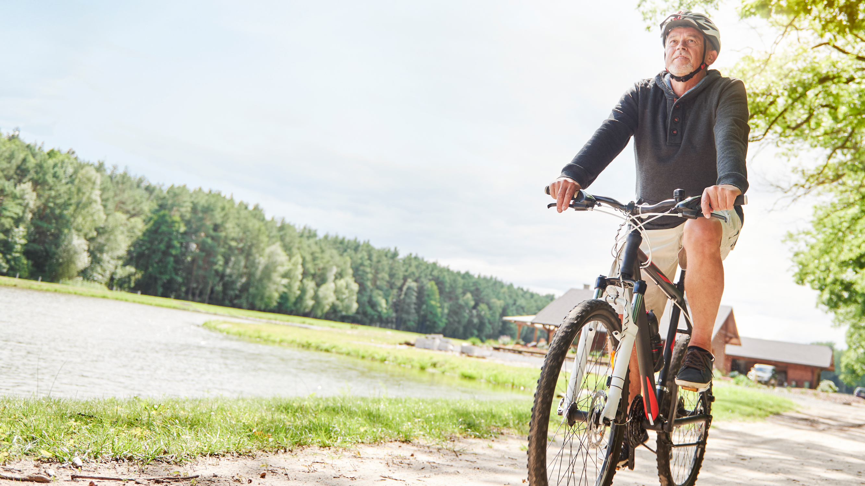
People thrive when empowered to make their own choices.
Even when we rely on others, being able to make decisions for ourselves is a key piece of the wellness puzzle.
AUTONOMY
SUPPORT BY: Relevance | Respect | Choice
Notes:
Autonomy is the need for a person to have control over their own decisions & behaviors. It is distinct from independence in the sense that with Autonomy, people can rely on support from others, while making their own decisions.
We can support Autonomy by:
Relevance – provide a clear rationale or explanation when decisions or requests are made. People tend to have more autonomy when they do things for internal/personal reasons.
Respect – acknowledge the individual’s feelings and their priorities. You may not agree with someone else’s choices, but they should be respected.
Choice – provide options and alternatives
ASK: How can you support residents’ autonomy in your role?
Choosing clothes, when to wake up, or what to eat
Open hours in art studios, gyms, and pools

Slide 10

Confidence comes from doing, learning, and knowing.
A powerful way to foster wellness is in the accomplishment on your own terms.
ACHIEVEMENT
SUPPORT BY: Optimal Challenge | Support | Skills Training
Notes:
Achievement is the need to demonstrate competence & mastery over one’s environment, or that one is learning & developing, while taking actions that lead to desired outcomes.
We can support Achievement by:
Optimal challenge – tailor the activity, the way in which the individual can meet their goal, to their interest and skill level
Support – provide social support
Skills training – provide opportunities to learn and develop skills
ASK: In your role, what can you do to encourage residents to try new things or develop new skills?
Designed programs in series rather than one-offs
If assisting with technology, teach the resident how to use the technology rather than doing it for them.

Slide 11

One of the most basic human needs is to belong. Keeping people connected to other people is critical to achieving long-term well-being.
AFFILIATION
SUPPORT BY: Providing opportunities for connecting with others | Creating a welcoming and inclusive culture
Notes:
Affiliation is the need to have close relationships & meaningful interactions w/ others. It includes receiving support, as well as providing support to others.
ASK: What are things that we do (or could do) to make the community welcoming to residents?
Emphasizing connection more than attendance
Arranging seats in a circular format for some events
Communication technology, like wireless mics and headphones
Musician-in-residence program that’s focused on relationships and small-group interactions, not just the performance

Slide 12





WELLNESS OUTCOMES
Research shows the 3 A’s are associated with:
GREATER HAPPINESS & LIFE SATISFACTION
LOWER PERCEIVED STRESS
GREATER RESILIENCE
BETTER SELF-REPORTED HEALTH
Notes:
Research from Mather Institute shows that people who have higher levels of the 3 A’s also report greater happiness, life satisfaction resilience, health and lower stress. The takeaway is that it’s important to consider how you can support the 3 A’s for your residents and team members.

Slide 13



WELLNESS:
THREE LEVELS OF INFLUENCE
No one lives in a vacuum. Our model recognizes that our wellness is affected by many different influences. These include:
PERSON- CENTRIC WELLNESS
INDIVIDUAL
COMMUNITY
SOCIETY
Notes:
No one lives in a vacuum. The model also recognizes that other things may impact wellness. There are good factors in each level of influence, and also negative ones. So our job is to draw out the positive variables and try to recognize and reduce the impact of the negative ones.

Slide 14

Personal Interests | Values | Beliefs | Attitudes
Knowledge | Personality
INDIVIDUAL
Notes:
There are individual differences between people that can impact their wellness. This can include things like genetics (predisposition to certain illnesses), personality factors (e.g., extraversion), different habits and behaviors, different interests and values, etc. There are also demographic factors such as income, education, even gender.
For example, the Age Well Study found that having higher optimism and a greater sense of purpose were associated with greater happiness and life satisfaction.

Slide 15

Relationships | Social Networks
Neighborhood Resources | Programs and Services
COMMUNITY
Notes:
Going beyond the individual, we can think about how our relationships with others and the communities we live in can impact our health. For instance, there’s research showing that people who have happier friends tend to be happier. Happiness is contagious.
This also includes things like walkability of the community, safety, access to medical care,

Slide 16

Politics | Economy | Culture
Norms, Values, Traditions | History
SOCIETY
Notes:
Stepping back even further, we can think about how societal and cultural factors can impact our well-being.
ASK: Can you share some societal factors that positively or negatively impact well-being?
The takeaway from this aspect of the wellness model is instead of thinking about wellness as just something we either succeed or fail at as individuals, think about the impact of the community. What avenues to well-being can you embed more deeply in our community for residents and employees? And conversely, what roadblocks to well-being can you remove in our community and society for residents and employees?

Slide 17
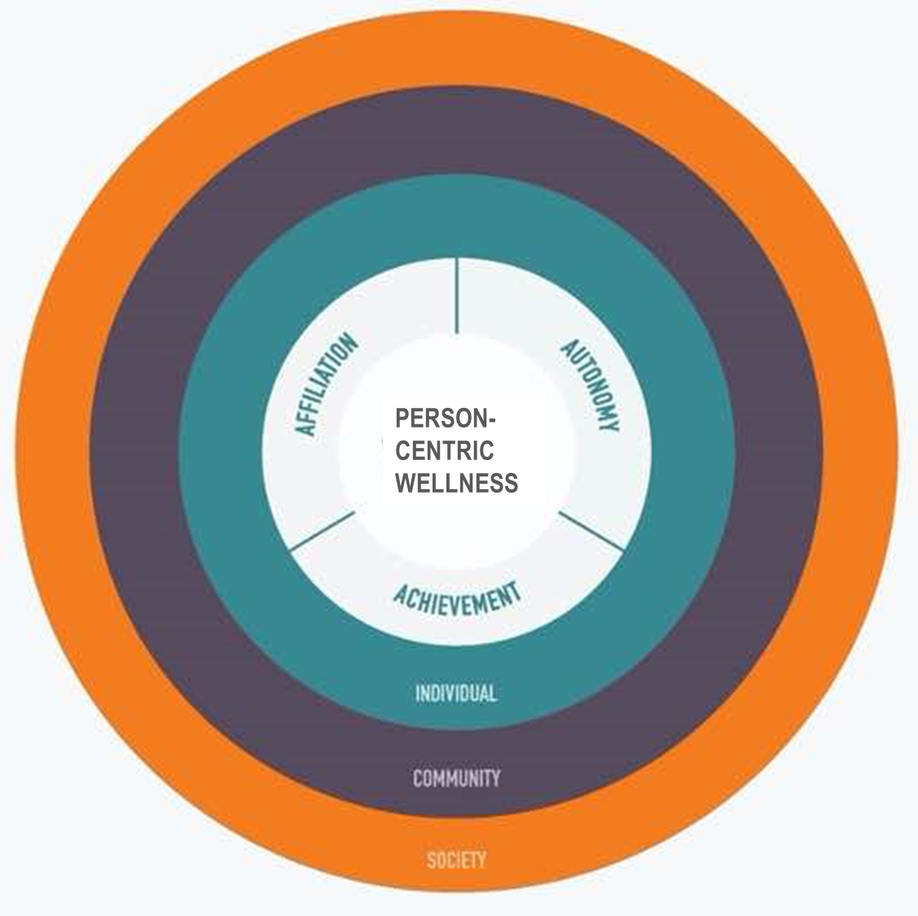
PERSON-CENTRIC WELLNESS MODEL
Everyone’s wellness journey is unique.
We are more likely to benefit from wellness efforts when we:
Feel like we can make choices that shape our lives (Autonomy)
Feel like we can reach and celebrate our goals (Achievement)
Feel connected to others (Affiliation)
Are within environments that support the 3 A’s and reduce obstacles
PERSON- CENTRIC WELLNESS
Notes:
(This slide can be used alone in meetings as a quick refresher of the Person-Centric Wellness Model.)
To sum everything up:
At the heart of the Person-Centric Wellness Model is the belief that everyone’s wellness journey is unique, and each person may have different wellness needs and goals. To support personal wellness, our model focuses on three As (autonomy, achievement, and affiliation).
We are more likely to benefit from wellness efforts when we:
Feel like we can make choices that shape our lives (autonomy)
Feel like we can reach and celebrate goals that are personally meaningful to us (achievement), and
Feel connected to others (affiliation)
And these elements are made even stronger when we are within environments that support equitable access to the 3 A's and strive to reduce obstacles. It’s not your choices alone that affect your wellness, outside factors can also help or limit our wellbeing. That’s why we recognize that we all have a role to play in creating a community in which wellness feels accessible to all who live and work here.

